Slide 1
STUDENT CENTRE EXPANSION PRESENTATION

Slide 2
STUDENT CENTRE EXPANSION

Slide 3
STUDENT CENTRE EXPANSION
Last expansion was in 1999 (for around 6500 students)
Expansion time
Year 1 - Referendum and planning
Year 2 - Planning and beginning of construction
Year 3 - Continued construction and opening of the new centre
Students-funded expansion fees Plan (at cost of $10 million)
Year 1 to 3 (lowered) - $10 per session per student
Year 4 until paid in full (full) - $30 per session per student
Commitment from the University of 0.5c to every $1 raised

Slide 4
UTM MASTER PLAN - EXPANSION
Review of UTM Master Plan
Plan to develop and expand campus in the next couple of years
Stages of Expansion
North Expansion/Renovation
Pub & Current Student Centre Renovation
Replacing the Annex Expansion (6 floor new building with a link to SC)
Cost between 10 to 15 million
Notes:
F/G

Slide 5
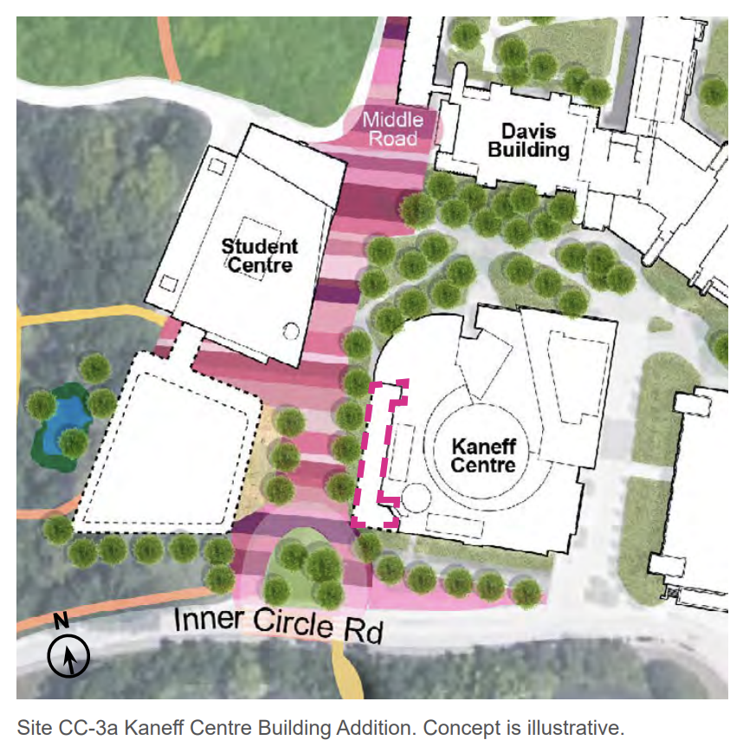
UTM MASTER PLAN - EXPANSION
Notes:
F/G

Slide 6
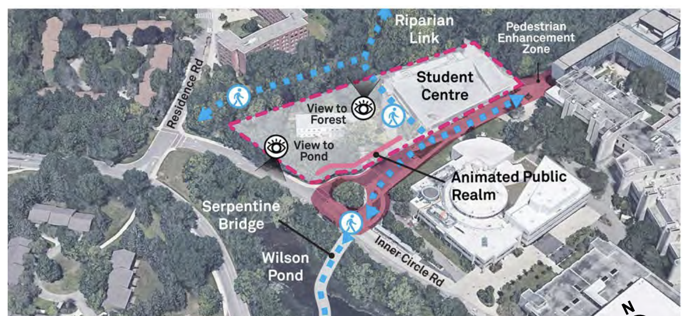
UTM MASTER PLAN - EXPANSION
Notes:
F/G

Slide 7
UTM MASTER PLAN - EXPANSION
Notes:
F/G

Slide 8
UTM MASTER PLAN - EXPANSION
Notes:
F/G

Slide 9
STUDENT FEEDBACK

Slide 10
EXPANSION PLANS (⅓)
Blind Duck Pub Expansion
Multipurpose Space
Academic Advocacy/Society Space
Multifaith/Prayer Space -
Student Space (Social/Study)
Individual study group spaces
Selling Space (Board Game Cafe?)
Rental Space
Pharmacy
Dental Office
Larger Convenience Store

Slide 11
EXPANSION PLANS (⅔)
Accessibility (new elevators, )
Sustainability Centre
Recycling center (books, pens, batteries,
Charging ports
Nap room/resting zone (bean bags, futons - challenges managing)
Decompression space/meditation room
Food centre expansion - with kitchen/tv for workshops
General event space (big/medium/small
UTMSU staff offices
Sports/Concert/Big events screening
Textbook exchange/library

Slide 12
EXPANSION PLANS (3/3)
Arcade space
Childcare centre (maybe for pets)
Larger bus stop

Slide 13
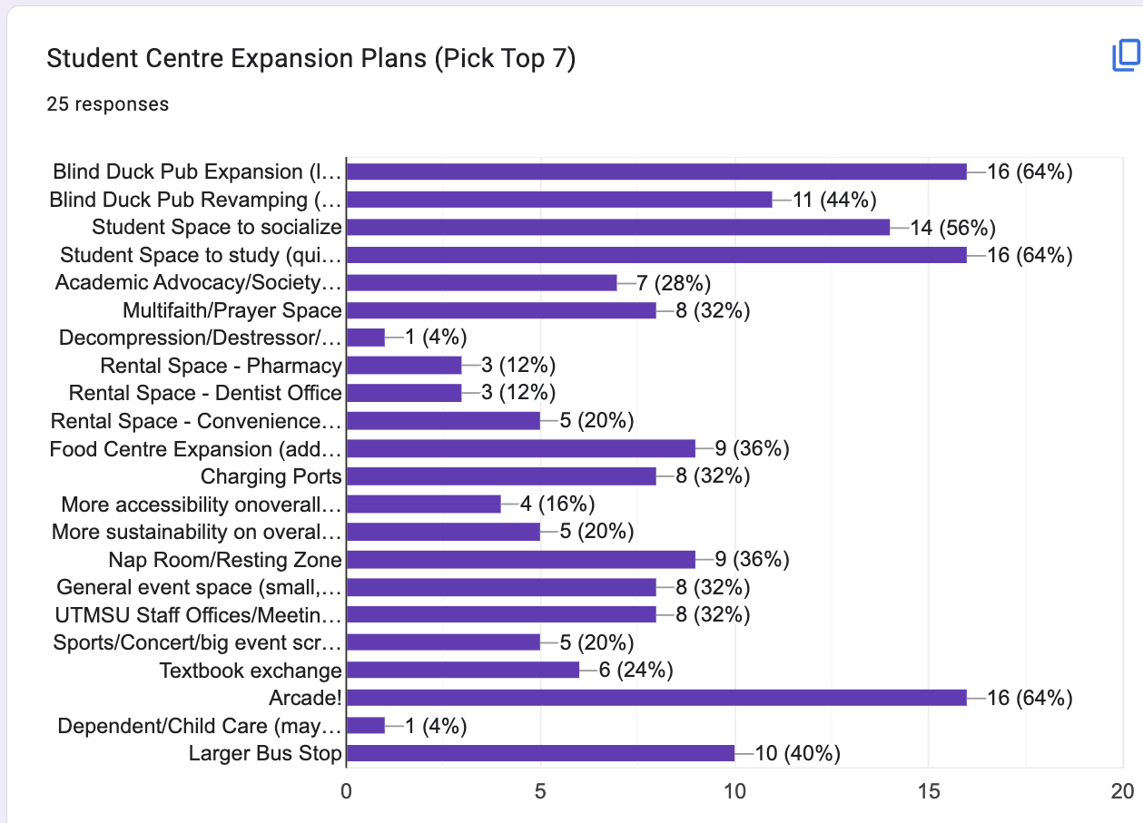

Slide 14
TOP PRIORITIES
Pub Expansion and Renovation
Arcade (Social Space)
Quiet Resting/Study Areas for students
Food Centre Expansion to include a community kitchen

Slide 15
OTHER PRIORITIES
Multifaith Space
Campus Groups Multipurpose Rooms for events and meetings
Overall building accessibility
Elevator
Better washrooms
Proper entrances with accessibility buttons

Slide 16
REFERENDUM
Notes:
Felipe

Slide 17
SC EXPANSION REFERENDUM
A vote to ask the membership (UTM Students) for something, in this case a levy fee implementation
Current Plan/Question*
Question: Are you in favour of the implementation of a Student Centre Expansion Levy Fee of $_____ (per student per semester) for the first three (3) years or until the building opens, and an increased of the levy to $_____ (per student per semester) until the completion of mortgage payments?
*subject to change
Notes:
Felipe

Slide 18
DATES
Prep Period
Organizing meeting with Campus Groups - TBD
September 20 - Student Centre Expansion Workshop with the University *tentative*
Referendum
October 9 to 13 - Reading Week & Planning Period
October 16 to 26 - Campaigning Period
October 18 - SC Expansion Forum
October 24 to 26 - Voting Days

Slide 19
REFERENDUM BUDGET
$2,000.00 - Printed Campaign Materials
$4,000.00 - General Outreach & Events
$7,000.00 - SC Expansion Fund for Campus Groups
$1,000.00 - Social Media/Virtual Promotion and Advertisement
$1,000.00 - Miscellaneous spending
$15,000.00 - TOTAL
Notes:
Felipe

Slide 20
FINAL THOUGHTS

Slide 21
FINAL THOUGHTS
This is a historic moment for the UTM student population, and for the campus: we get to build our own building!
Your voice matters!

Slide 22
THANK YOU!

